Slide 1
Delaware County’s No Wrong Door
Social Services & Community Programs
~ Court & Community Connections ~

Slide 2
No Wrong Door
Delaware County’s No Wrong Door is a collaborative effort by County Council, Social Services and Community Programs to provide residents with a centralized and coordinated process to streamline access to our programs and providers.
This approach strengthens our communities and allows residents to evaluate available options and make informed decisions about accessing supportive services.
When we link our residents to Social Services and Community Programs such as food, shelter, treatment, early intervention, and subsidized childcare, we are increasing their resiliency and decreasing their risk of becoming unhoused, addicted, ill, and entering poverty or the criminal justice system.

Slide 3
Social Services & Community Programs Offices
County Offices of Services for the Aging
Delaware County Libraries
Department of Military & Veterans Affairs
Office of Adult & Family Services
Office of Children & Youth Services
Office of Drug & Alcohol
Office of Early Intervention
Office of Housing & Community Development
Office of Intellectual & Developmental Disabilities
Office of Mental Health

Slide 4
County Offices of Services for the Aging (COSA)
The Department of County Government responsible for planning, coordinating, and administering programs and services for the County's population 60 and older. COSA's goal is to enable senior citizens to maintain their independence and dignity, remain in their own homes and communities with appropriate support services, and to deter or prevent unnecessary institutionalization. Special emphasis is placed on serving those who are frail, living alone and are functionally disabled or otherwise in social or economic need.
County Offices of Services for the Aging- 610-490-1300 or 800-416-4504
Adult Protective Services- 610-490-1300 or 800-416-4504

Slide 5
Delaware County Libraries (DCL)
Delaware County Libraries is a federated system comprised of 26 member libraries with 28 locations in the western suburbs of Philadelphia, PA. As an agency of County government, our goal is to optimize library service to the citizens of Delaware County through cooperative efforts. An Administrative Headquarters provides support to the member libraries. All member libraries remain independent and set their own policies and procedures.
Delaware County Libraries- (610) 891-8622

Slide 6
Delaware County Libraries (DCL)
DCL services include:
Electronic resources including eBooks and downloadable audiobooks, along with the POWER Library--high quality research resources not available on the free Internet
Interlibrary loan and van delivery among all libraries
2.1 million print and online materials
Preschool outreach including storytimes
Coordinated programs for children and young adults
A centralized collection of puppets, big books, and theme kits for educators
Outreach programs and services to older adults

Slide 7
Delaware County Libraries (DCL)

Slide 8
Department of Military & Veterans Affairs Flyer

Slide 11
Community Action Agency- Housing for Veterans

Slide 12
EDSI Veterans Career Program

Slide 13
Office of Adult & Family Services (AFS)
Office of Adult and Family Services- oversees a wide range of services and programs to adults and families in Delaware County. These services and programs are delivered by a pool of provider agencies who have many years of experience working within their respective fields. Through contract agreements with providers, Office of Adult and Family Services programs are designed to help determine the best level of care and referrals that are needed to stabilize and support people in Delaware County. These include: Community-wide coordination of Homeless Services via The Homeless Service Coalition (HSC); Services that fall under the Continuum of Care (CoC) for homeless programs; Homeless prevention programs; Emergency shelter and permanent housing programs; Food assistance programs (food pantries); Medical Assistance Transportation Program (MATP); HIV/AIDS housing and services; Delaware County Family Center.
Homeless Outreach- 267-671-4357

Slide 14
Coordinated Entry Assessments
Community Action Agency: 1414 Meetinghouse Rd., Boothwyn
Mon. to Fri., 8:00 AM – 3:00 PM; hours may vary (610) 874-8451
Community Action Agency: 7408 West Chester Pk., Upper Darby
Mon. to Fri., 9:00 AM – 4:00 PM; hours may vary (610) 947-0693
Horizon House: Phone assessments, call (610) 328-1306, x31131
Mon. to Fri., 9:00 AM – 4:00 PM; hours may vary
Salvation Army: 151 West 15th St., Chester (610) 874-0423
Mon. to Fri., 9:00 AM – 4:00 PM; hours may vary
Horizon House: Mobile Assessments, call (610) 328-1306, x31131

Slide 15
Office of Adult & Family Services Map

Slide 16
Coordinated Entry

Slide 17
Homeless Services Guide

Slide 18
Food Pantry Sites

Slide 19
Office of Children and Youth Services (CYS)
Office of Children and Youth Services- provides for the immediate safety and protection of children, to keep children with their own families whenever possible, to provide temporary, substitute care for children when necessary and to reunite children with their families as quickly as possible after placement. In all cases CYS provides case management, counseling, and related supportive services to abused and/or neglected children from birth up to age 18, and their families. We work directly with children and families in times of crisis while keeping with the agency's mission/goals. The agency offers services to stabilize and offers rehabilitative services to reunite the family.
Office of Children & Youth- 800-416-4511 or After Hours 610-892-8400
ChildLine- 800-932-0313

Slide 20
Office of Children & Youth Services Map

Slide 21
Office of Children & Youth Services Brochure

Slide 22
Office of Children & Youth Services Brochure

Slide 23
Office of Drug & Alcohol (D & A)
Also referred to as the Single County Authority (SCA), is an administrative office that oversees the delivery of treatment and prevention services in Delaware County. The Division of Drug and Alcohol Programs provides funding for prevention, intervention, and treatment services (including inpatient and outpatient levels of care) to all eligible Delaware County children, adults, and families.
Keystone Center- Assessment- 610-876-9000 / 24/7 Mon- Fri
MVP Recovery- Assessment 855-687-2412 / 7am-3pm Mon- Fri
Merakey- Assessment- 610-537-1765 / 8:30am-1:30pm Mon- Fri
American Treatment Network- 877-286-5115 / 8am-8pm Mon- Fri

Slide 24
Office of Drug & Alcohol Adolescent Service Map

Slide 25
Office of Drug & Alcohol Adult Service Map

Slide 26
Office of Drug & Alcohol Brochure

Slide 27
Office of Drug & Alcohol Brochure

Slide 28
Alcohol, Tobacco, & Other Drugs Prevention Services

Slide 29
Anchor Providers

Slide 30
Anchor Providers

Slide 31
Certified Recovery Specialist

Slide 32
Certified Recovery Specialist

Slide 33
Pregnant Women & Women with Children Resources

Slide 34
Pregnant Women & Women with Children Resources

Slide 35
Office of Early Intervention (EI)
Provides evidenced-based coaching supports and services to infants/toddlers (birth to age 3) and their families when children are experiencing a developmental delay or have a diagnosis that results in developmental delay. The support and services are at no cost to eligible infants, toddlers, and their families. The Office of Early Intervention is part of a statewide Early Intervention System under the direction of the State Bureau of Early Intervention, Office of Child Development and Early Learning.
Office of Early Intervention- 610-713-2406

Slide 36
Office of Early Intervention Service Map

Slide 37
Office of Early Intervention Brochure

Slide 38
Office of Early Intervention Brochure

Slide 39
Office of Housing & Community Development (OHCD)
The mission of the Office of Housing and Community Development is to promote sound housing and community development in Delaware County with the use of federal, state and local resources.
OHCD is responsible for the planning, administration, and oversight of three federal programs: the Community Development Block Grant (CDBG), HOME Investment Partnerships (HOME) and Emergency Solutions Grants (ESG) Programs.
The office is also charged with oversight of state initiatives funded through the Pennsylvania Department of Community and Economic Development and County initiatives, as funds become available.
Office of Housing & Community Development at 610-891-5425

Slide 40
Office of Intellectual & Developmental Disabilities (OIDD)
Serves all eligible individuals with intellectual and developmental disabilities, and/or autism spectrum disorder who live in Delaware County. Our goal is to improve the lives of people with disabilities. The Delaware County Administrative Entity monitors all service providers and Supports Coordination Organizations serving residents of Delaware County to ensure that they follow Pennsylvania Office of Developmental Programs guidelines. Administrative Entity functions include intake and eligibility determination, provider relations, service authorization, systems coordination, quality management, incident management, and eligibility for and coordination of funding sources. The Delaware County Supports Coordination Organization provides case management services that connect individuals and families to community resources, both paid and unpaid, to provide them with the opportunity to have a self-determined, meaningful lifestyle.
Office of Intellectual and Developmental Disabilities- 610-713-2400

Slide 41
Office of Intellectual & Developmental Disabilities Service Map

Slide 42
Office of Intellectual & Developmental Disabilities Brochure

Slide 43
Office of Intellectual & Developmental Disabilities Brochure

Slide 44
Supports Coordination

Slide 45
Office of Mental Health (MH)
Mental Health is an administrative office within the Delaware County Department of Human Services. This office assures appropriate services are available for children, adolescents and adults who experience mental health challenges. We contract with agencies who provide an array of services and resources which are focused on the principles of recovery, resiliency, and self-determination. Our County and HealthChoices funded Programs include Psychiatric Rehabilitation, Outpatient Treatment, Case Management, Residential Support Services, Acute Inpatient Treatment, Crisis, and Peer Support Services, Community-Based services, In-Home Based services, School-Based Services, Partial Hospitalization, Mobile Crisis, and Crisis Center.
Delaware County Mobile Crisis Services- 855-889-7827

Slide 46
Office of Mental Health Adolescent Service Map

Slide 47
Office of Mental Health Adult Service Map

Slide 48
Office of Mental Health Brochure

Slide 49
Office of Mental Health Brochure

Slide 50
Mental Health Crisis Court

Slide 51
Mental Health Crisis Court

Slide 52
Mental Health Crisis Services

Slide 53
Healthy Kids, Healthy Schools Initiative: ConnectED Program

Slide 54
ConnectED Program
Delaware County’s ConnectED Program is a comprehensive initiative designed to support the academic social, emotional, and behavioral well-being of students within the County School districts.
Grounded in the belief that every student deserves access to a nurturing and inclusive learning environment the program integrates assessment, intervention and support services to address a wide range of students needs.

Slide 55
ConnectED
ConnectED operates under the realm of prevention and early intervention which allows the opportunity for parents, caregivers, and educators to call MVP and speak to a live person 24/7 even if they may have a simple question about resources, how to identify behavioral health concerns or need a linkage to a provider
Weekdays from 8:30- 4:30pm the ConnectED Coordinator triages the youth and links them to appropriate services in actual time.
This is what makes ConnectED stand out from our traditional behavioral health treatment referral processes and Student Assistance Programs, it is providing an immediate warm hand off to the right door!

Slide 56
ConnectED Mission & Objectives
Mission is to promote student success by identifying and addressing barriers to learning and well-being.
Core Objectives:
Early Intervention: Identify students who may be experiencing academic, social, emotional, or behavioral difficulties as early as possible to prevent academic failure and disengagement.

Slide 57
ConnectED Objectives
Collaboration: Foster collaboration among school personnel, parents, students, and community partners to coordinate services share information and maximize resources.
Prevention and Education: Provide prevention programs, educational workshops, and resources to promote positive mental health, social-emotional skills, and resilience among students, staff and families.

Slide 58
Collaborative Partnerships: The success of the ConnectED Program relies on strong collaboration and partnerships among various stakeholders including:
-School Administrators, Teachers, Counselors and Support Staff
-Parents, Guardians, and Families
-Mental Health Professionals
-Medical Providers and Community Health Organizations
-County and Community agencies and organizations providing social services, enrichment programs, and extracurricular activities

Slide 59
Contact ConnectED:
MVP Recovery
855-687-2410

Slide 60
DelCo CONTACT- Family Peer Connection Program

Slide 61
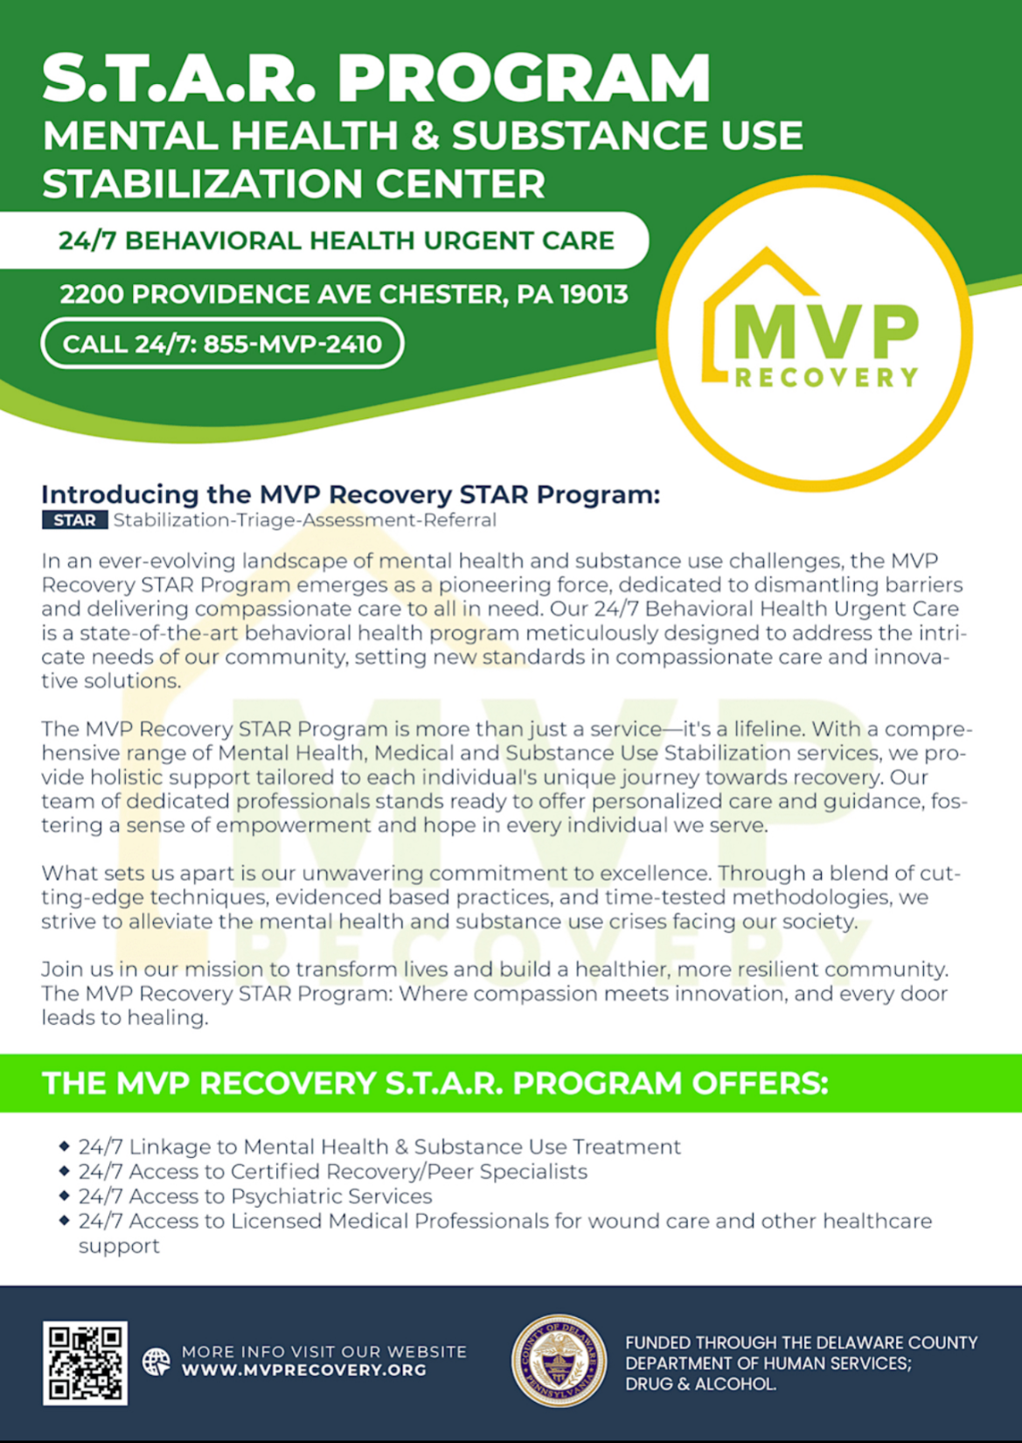

Slide 62
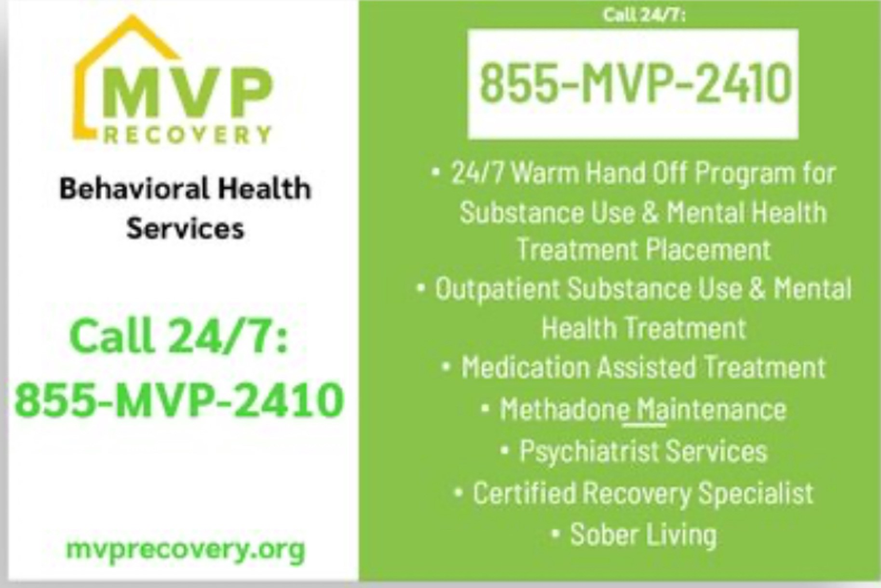

Slide 63
DelCo Crisis Connections Team

Slide 64
DelCo Crisis Connections Team

Slide 65
DelCo Warm Line

Slide 66
DelCo Crisis Telehealth Helpline

Slide 67
Human Services Brochures and GIS Maps
Human Services Brochures:
Human Services Brochures - Delaware County Department of Human Services (delcohsa.org)
GIS MAP:
GIS Maps - Delaware County Department of Human Services (delcohsa.org)

Slide 68
No Wrong Door Outreach
We are currently available to provide a stadium folder that contains our brochures to be displayed in our county offices, libraries, schools, and our community partners to increase awareness of our services and programs.
If you would like to schedule a brief meeting with us to drop off a stadium folder and provide an overview of our services, we would be happy to be to do so.
Please contact us at 610-713-2115 Monday- Friday between the hours of 8:30am- 4:30pm or via email NoWrongDoor@delcohsa.org

Slide 69
Contacting DelCo’s No Wrong Door
To better assist our residents with accessing our services, we have a dedicated No Wrong Door phone number where residents can call to inquire about services or receive assistance in being
linked to our programs.
Please call 610-713-2115 Monday- Friday between the hours of 8:30am- 4:30pm or via email at NoWrongDoor@delcohsa.org

Slide 70
Thank you!!!

Slide 71
County of Delaware

