Slide 1
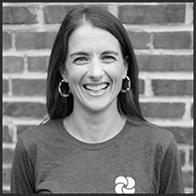
Gwenn Nolan Founder & CEO, Mother Compost

Slide 2
EXPLORING THE INTERSECTION OF WASTE + WONDER
Building Connection Through Composting
Gwenn Nolan, Founder + CEO

Slide 3
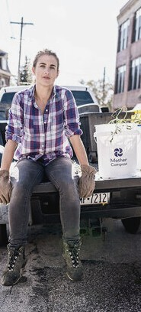
Gwenn Nolan
FOUNDER + CEO
Launched Mother Compost in the fall of 2018
Grown to service 1.2K residential subscribers and over a dozen local businesses & universities
MOTHER OF 3
The reasons I started on this crazy adventure

Slide 4
Nature has millions of mysteries to discover
Did You Know?
One teaspoon of soil contains more living organisms than there are people in the world.
The ocean produces 85% of the world's oxygen
Trees share nitrogen, carbon, water & other minerals through the "mycorrhizal network" created by mycelium, which is the thread like part of a larger fungal organism
Has been referred to as the "wood wide web"
There are 8.7 million species estimated by scientists to exist on the planet today.
We have only identified around 1.2 million - roughly 14% Homo sapiens are the only species that creates "waste"
And we create ALOT of it - 292.2 million tons each year

Slide 5
How much food do we throw away in the US each year?
33 billion pounds
87 billion pounds
108 billion pounds
Unclear - but I ' m getting the sense it' s a lot.

Slide 6
108 Billion Lbs.
He re in t h e U S, w e t h ro w a w a y 4 0 % o f o u r f o o d
su p p ly a n n u a lly
THE RESULTS

Slide 7
When we waste food,
we also waste Resources used to Grow Food:
Land (52% used for ag)
Water (80% of freshwater supply) Labor
Energy - transportation, storage, etc.
8% is composted*

Slide 8
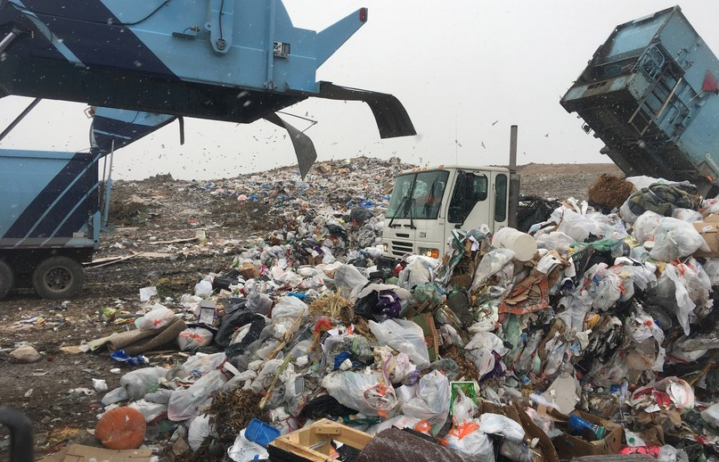
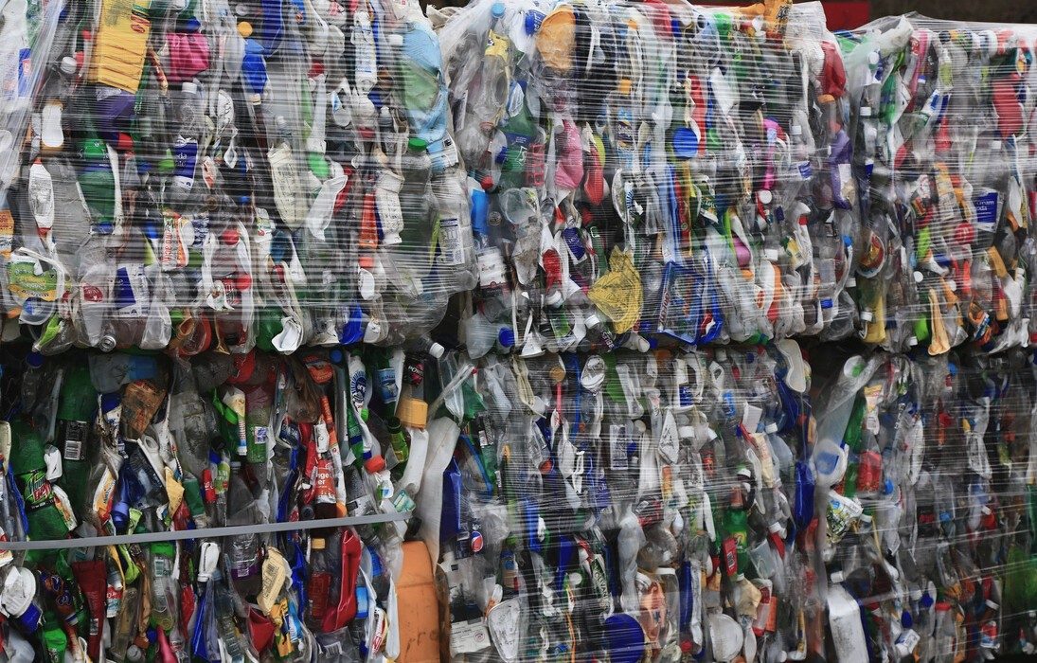
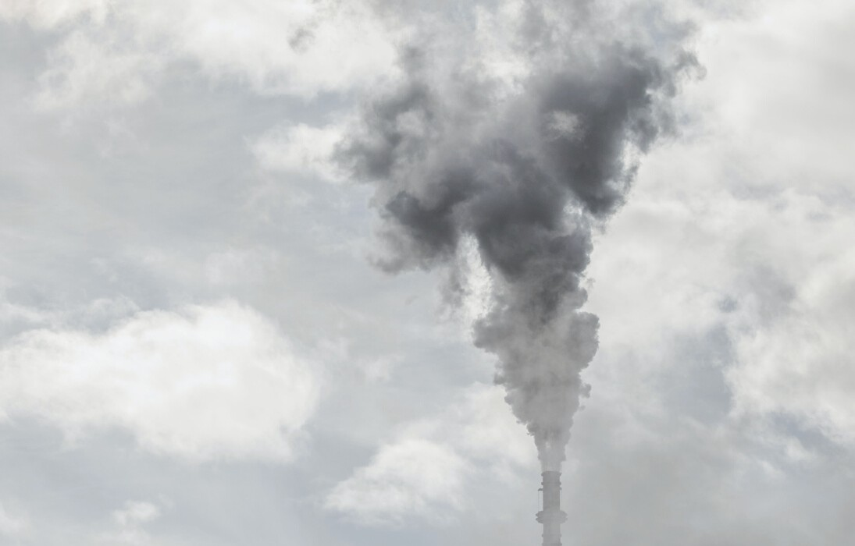
LANDFILLS - 52 % US / 1 % DELCO
Meant to store trash - not process
Organic materials cannot biodegrade properly due to lack of oxygen
WHERE DOES
THE REST
GO?
INCINERATORS - 13 % US/ 68 % DELCO
Called "Waste to Energy"
Studies connect health issues resulting from living close to these facilities, which are often located in economically impoverished areas.
RECYCLING - 26 % US / 27 % DELCO
Most commonly recycled materials are paper /
cardboard & metals
Glass & metal are infinitely recyclable

Slide 9
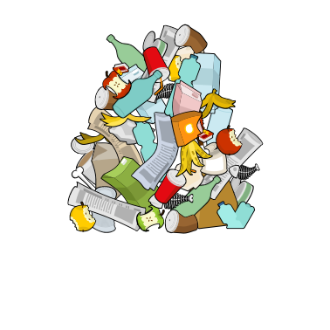
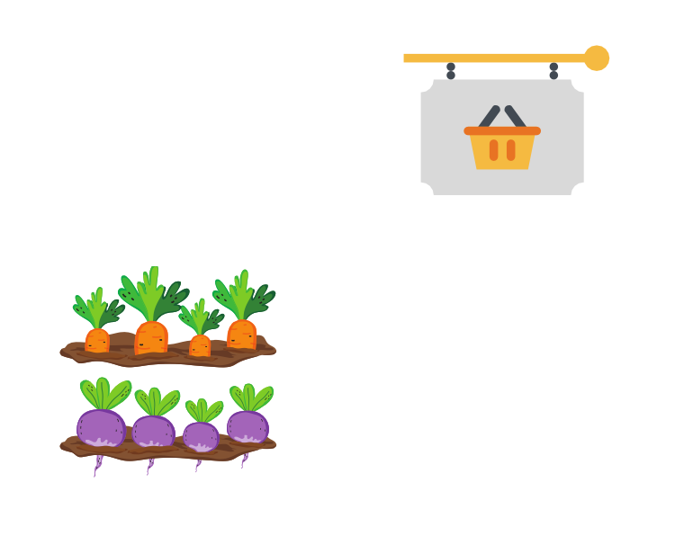
Linear Waste Stream
L A N D F I L L
T R A S H
H O M E
G R O C E R / M A R K E T ' S
F A R M S

Slide 10
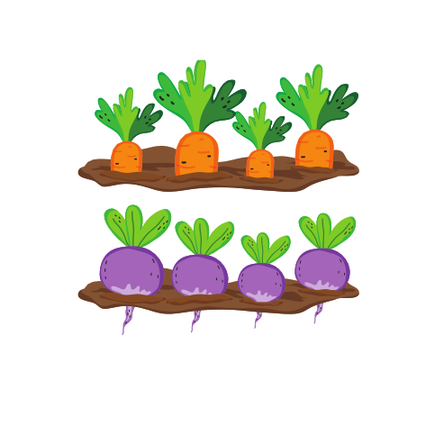
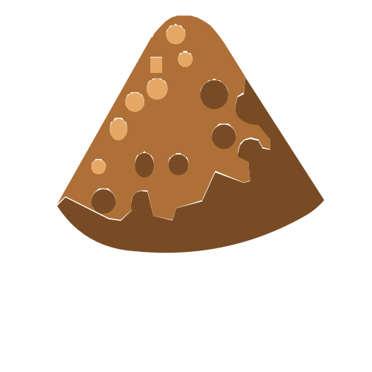
G R O C E R / M A R K E T ' S
H O M E
Circular waste Stream
F A R M S
M C B U C K E T
C O M P O S T P I L E

Slide 11
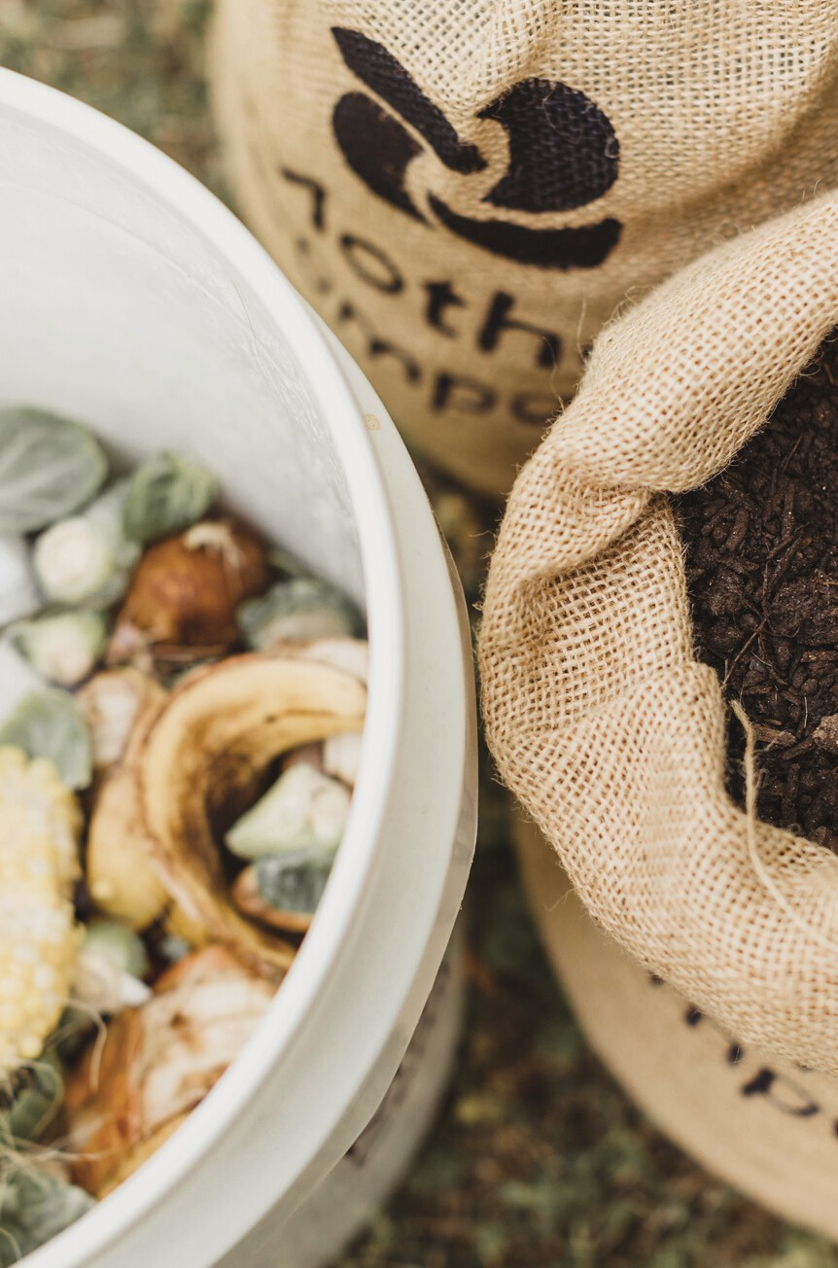
What Exactly is composting?
Composting (verb) – A process that works to speed up the natural decay of organic materials by creating ideal environments for detritus-eating organisms to thrive
Also used to describe separating food scraps & organic matter from trash
Compost (noun) – a nutrient rich soil amendment that helps sequester carbon and return nutrients from organic waste back to soils

Slide 12
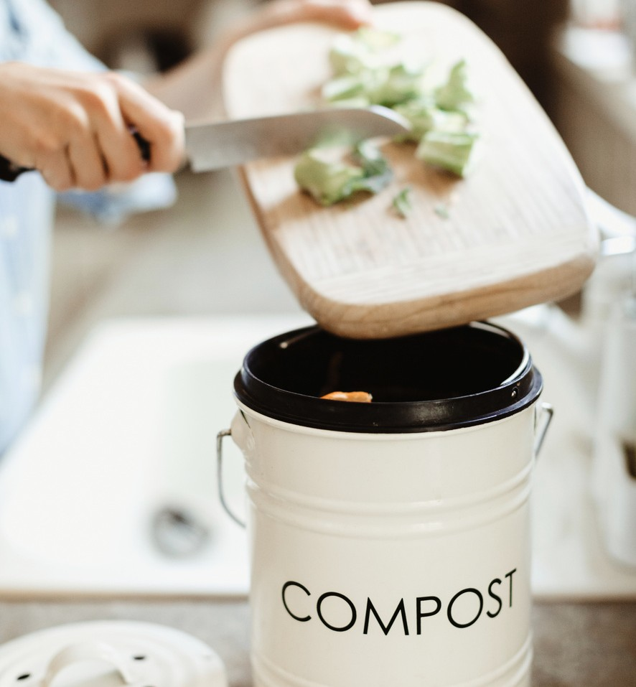
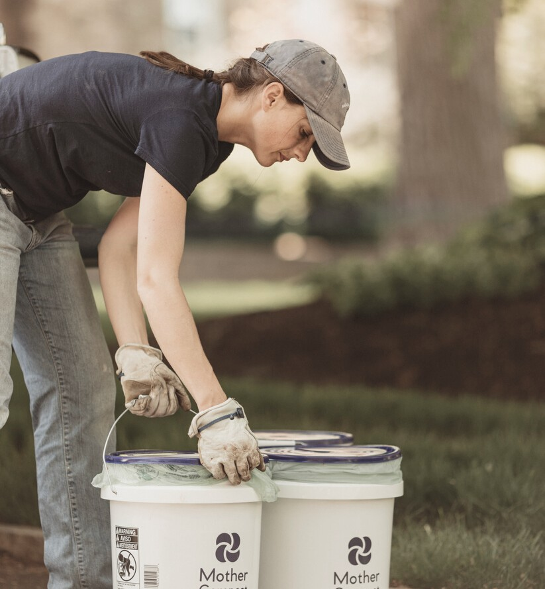
Composting simulates natures waste management
design.
It replenishes depleted soils with essential microorganisms
and nutrients.
Healthy soils = healthy foods =
healthy humans.
How It Connects

Slide 13
Dive into the Compost Pile

Slide 14
WHAT COMPOSTING HAS TAUGHT ME
Look for Solutions by Observing Nature
As we create "new" things or try to solve current issues, we should look to the natural world for examples. With millions of years of R&D already completed, there's a good chance the solution exists.
We are Part of the Natural World
Recognition that the environment is not what's outside, it is also each of us .
Re-connecting with the natural word kindles wonder & curiosity.

Slide 15
FIND US AT:
MOTHERCOMPOST. COM
INSTA: @ MOTHERCOMPOST FB: @ MOTHERCOMPOST
CONTACT OUR TEAM:
INFO@ MOTHERCOMPOST. COM
Thank you

